Slide 1
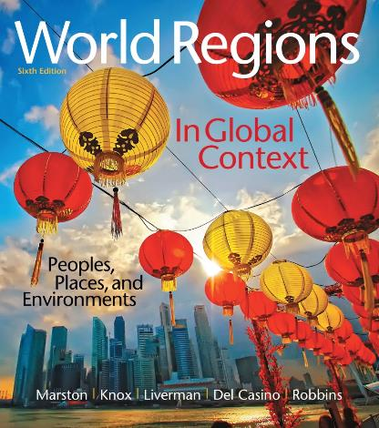
World Regions in Global Context:
Peoples, Places, and Environments
6th Edition
Europe
Lectures by:
Christa Ann Smith

Slide 2
Learning Outcomes
Analyze how Europe’s landscapes developed around regions of distinctive geology, relief, landforms, soils, and vegetation.
Explain the rise of Europe as a major world region and understand how Europeans established the basis of a worldwide economy.
Describe the reintegration of Eastern Europe.
Summarize the importance of the European Union and its policies.

Slide 3
Learning Outcomes
Identify the principal core regions within Europe.
Assess the importance of language, religion, and ethnicity in shaping ongoing change within Europe.
Describe Europe’s patterns of demographic change and urban development.

Slide 4
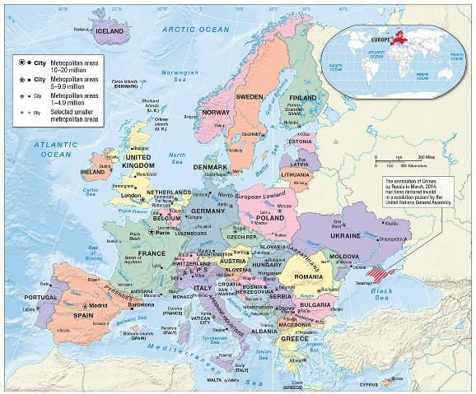
Environment, Society, and Sustainability
Central location
Peninsulas and islands
Navigable rivers
  Danube
  Dnieper
  Elbe
  Rhine
  Seine
Watersheds (drainage areas)

Slide 5
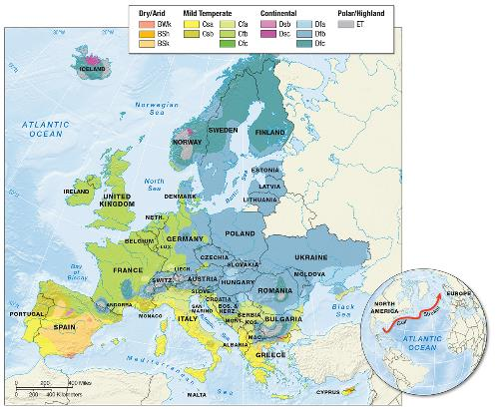
Climate and Climate Change
Northwestern Europe
  moderating effect of the sea
Eastern Europe
  seasonal extremes
Mediterranean Europe
  cool winters and hot, dry summers
Climate change
UN Kyoto Protocol
  Emissions Trading Scheme (ETS)

Slide 6
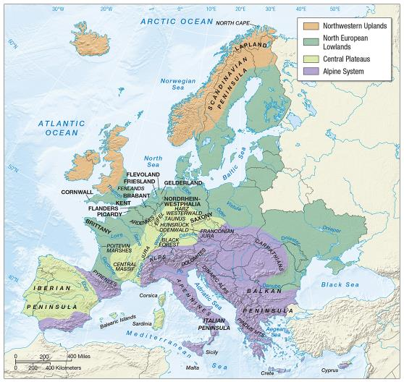
Geological Resources, Risk, and Water
Four principal physiographic regions
Landscape product of centuries of human adaptation
  aspect

Slide 7
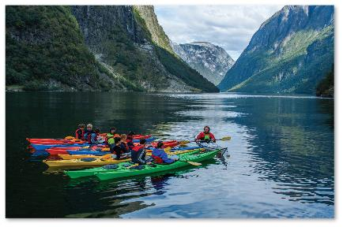
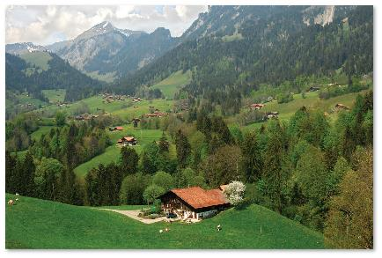
Geological Resources, Risk, and Water (cont.)
Northwestern Uplands
  oldest rocks in Europe
  uplands (high, hilly)
  cirques (deep, bowl
  mountainside basins)
  fjords
  moraines
Alpine Europe
  agriculture
  tourism

Slide 8
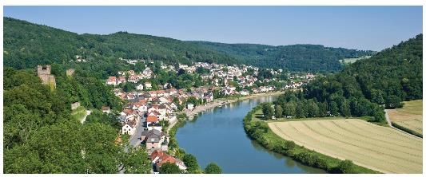
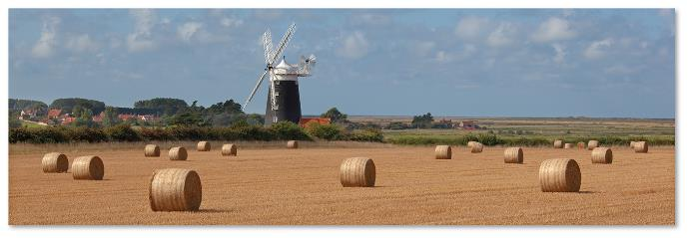
Geological Resources, Risk, and Water (cont.)
Central Plateaus
  Europe’s coal field
  massif
  forests
North European Lowlands
  flat or gently undulating
  region of farming and settlements
  loess
  steppe

Slide 9
Ecology, Land, and Environmental Management
Medieval Europe
  significant transformation
  drainage schemes
  Little Ice Age
Modern Landscape
  polders (low-lying areas reclaimed from the sea)
Industrialization
  mining
  pollution
  acid rain

Slide 10
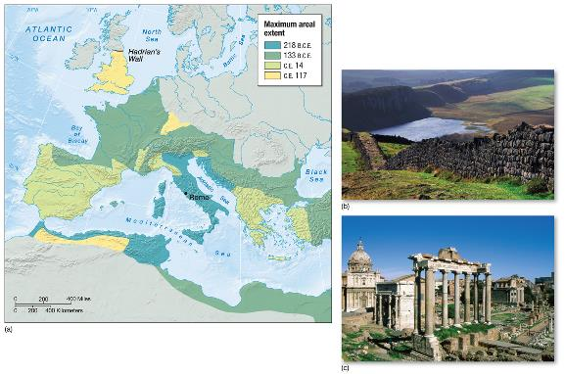
History, Economy, and Territory
Europe’s foundations laid by Greeks and Romans
  cities
  agriculture
  self-sufficiency
Decline of Roman Empire
  feudal system

Slide 11
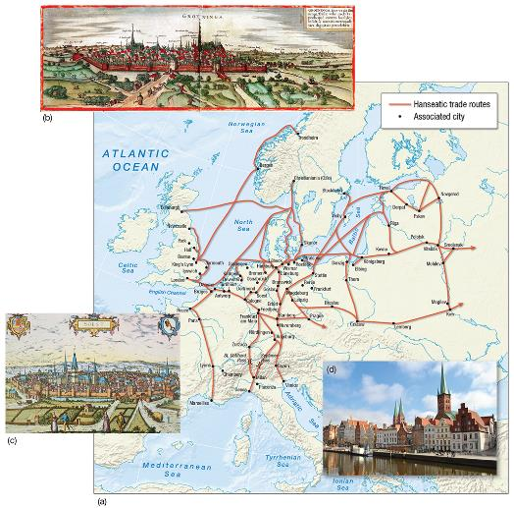
Historical Legacies and Landscapes
Mercantile capitalism
Age of Discovery
  innovations in business and technology
  geographical knowledge
  shift in orientation to the Atlantic
  entrepôt

Slide 12
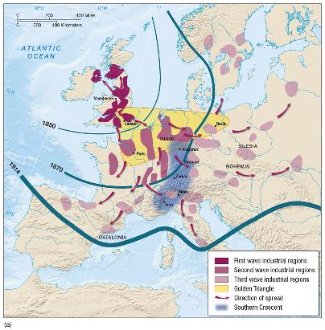
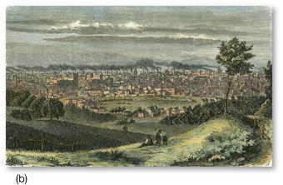
Historical Legacies and Landscapes (cont.)
Colonization
  resource extraction
  improvements in navigation
  and weaponry
  rise in industrial capitalism
Industrialization
  technology systems
  first wave
  second wave
  third wave

Slide 13
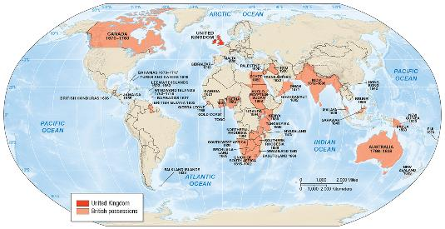
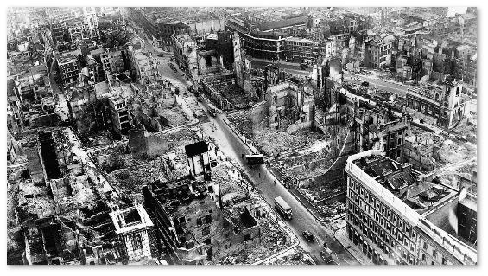
Historical Legacies and Landscapes (cont.)
Imperialism
Disruption
  WWI
  Great Depression
  WWII
Rebuilding
  Marshall Plan
  state socialism

Slide 14
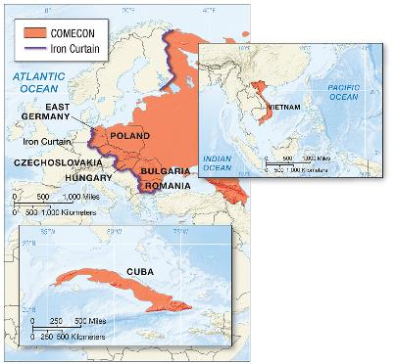
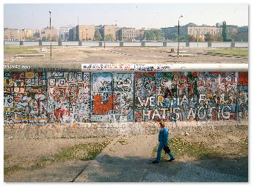
Historical Legacies and Landscapes (cont.)
Eastern Europe becomes a buffer zone
  Iron Curtain
Satellite states
  command economies
  COMECON
  industrial growth, but drab cityscapes

Slide 15
Historical Legacies and Landscapes (cont.)
Fall of state socialism
Market reforms
Reintegration
  cheap land and labor has brought in foreign investment
  inflation, unemployment, and homelessness appeared quickly
  countries still struggling
  countries well integrated

Slide 16
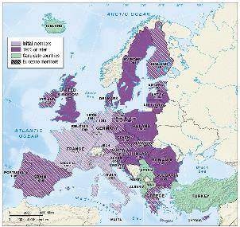
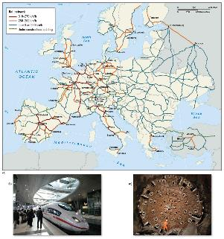
Economy, Accumulation, and the Production of Inequality
35% of world’s exports
33% of the world’s aggregate gross national income (GNI)
  welfare state
  social housing
European Union (EU)
  common agriculture policy
Maastricht Treaty
  euro

Slide 17
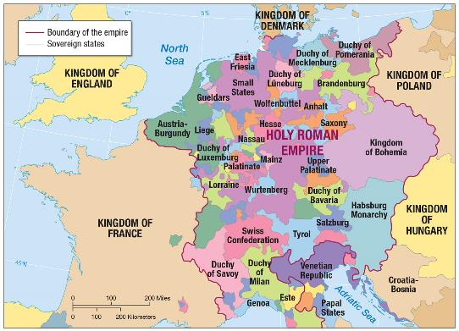
Territory and Politics
Enlightenment
  rise of nation–states
Regionalism
  ethnic minorities
  violence and political autonomy
  irredentism

Slide 18
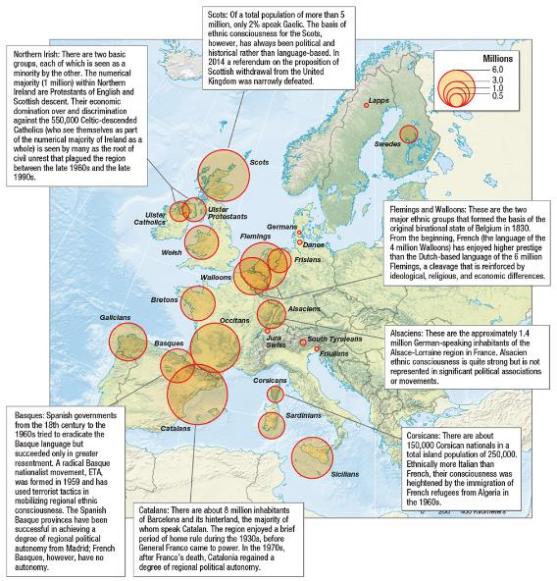
Territory and Politics (cont.)
Ethnic conflict
  balkanization
  enclaves and exclaves
  ethnic cleansing
  Kosovo

Slide 19
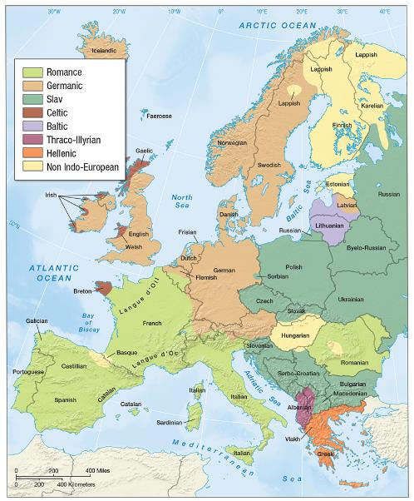
Cultures and Populations
Religion
  Roman Catholic
  Protestant
  immigrants and Islam
  rise of secularism
Language
  Romance
  Germanic
  Slavic

Slide 20
Cultural Practices, Social Differences, and Identity
Modernity
European identity
  immigration law
  xenophobia
Women in European society
  gender inequality
  income gaps

Slide 21
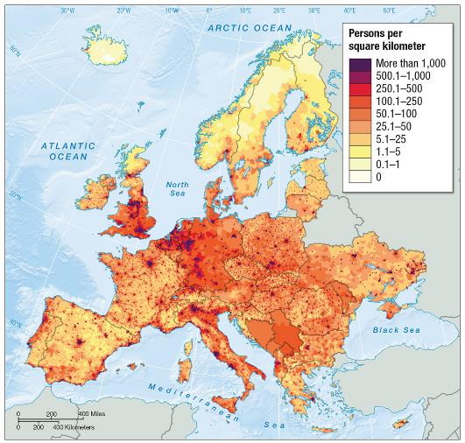
Demography and Urbanization
Densely populated
Stable growth
Baby bust
Increased life expectancies

Slide 22
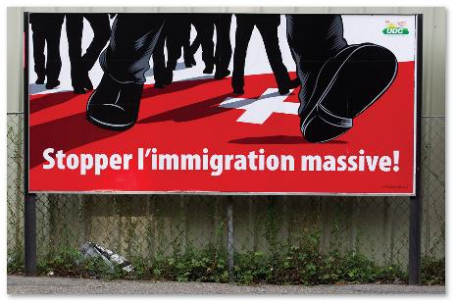
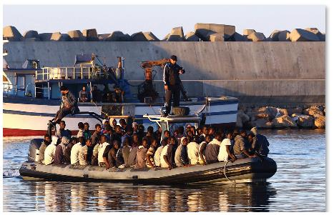
Demography and Urbanization (cont.)
European diaspora
Migration within Europe
  industrialization and conflict
  rural to urban
Recent migration streams
  labor migrants
  war and persecution

Slide 23
Europe’s Muslims
Western European cities
  migrant workers
  asylum seekers
  refugees
Resistance to cultural assimilation
  discrimination

Slide 24
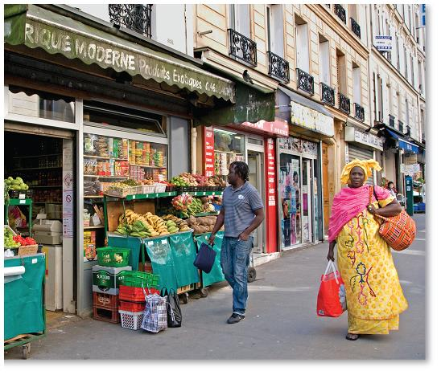
Europe’s Towns and Cities
Highly urbanized
World cities
Traditional market towns

Slide 25
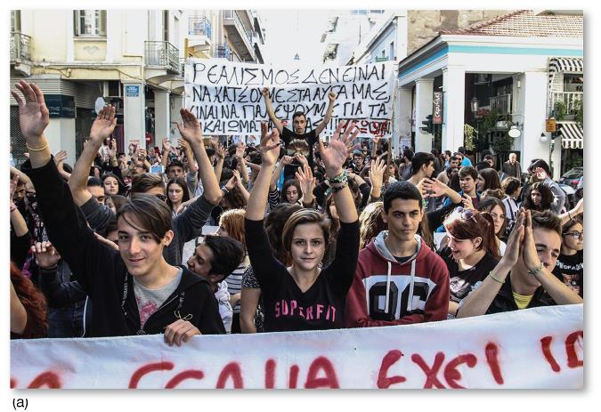
Future Geographies
Coping with aging populations
Economics and politics of immigration

Slide 26
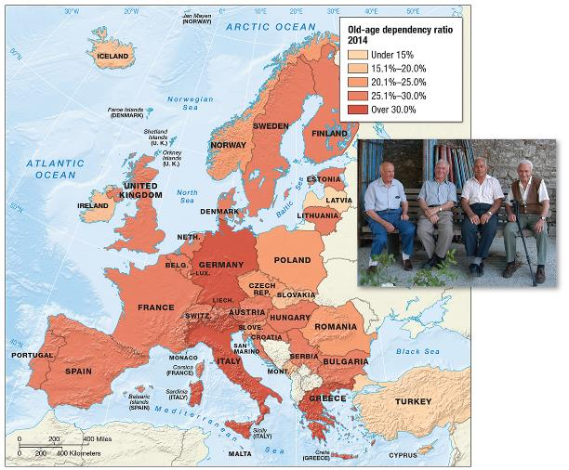
Coping with Aging Populations
Europe has 19 of the world’s 20 oldest countries
Old-age dependency ratios increasing

Slide 27
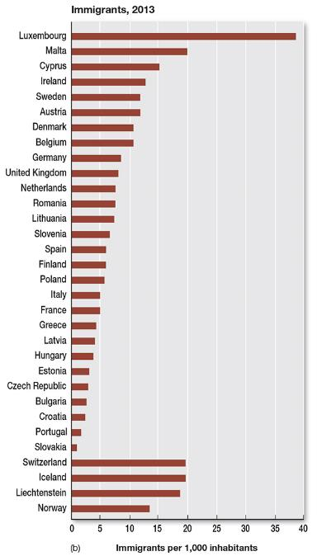
Coping with Immigration
North Africa/Middle East immigrants
Growing Muslim population
  social and cultural conflict

Slide 28
The EU: Costs of Expansions
Expansion of EU costly
  EU subsidies to new member countries account for more than 40% of total budget

Slide 29
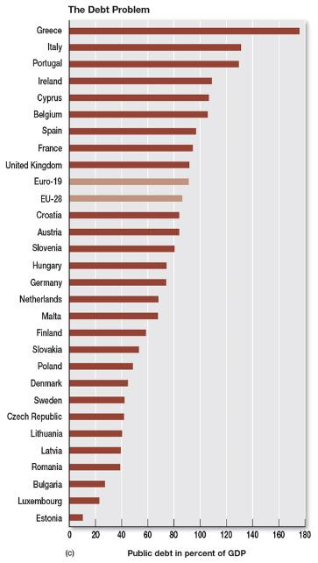
The EU: Problems of Indebtedness
Weak European countries tied to stronger ones through the Eurozone

